Slide 1
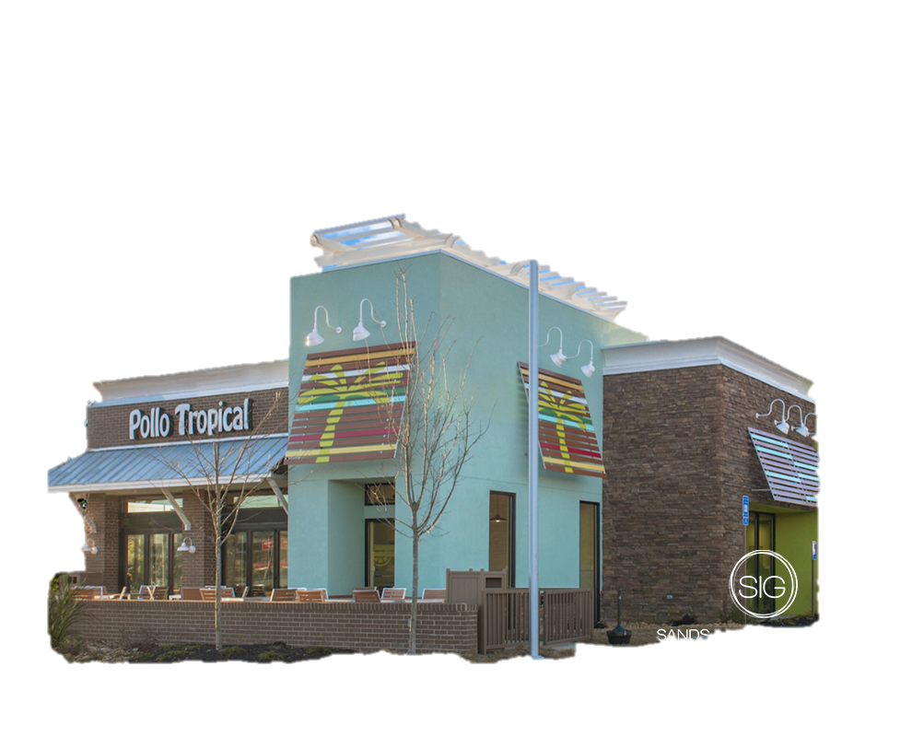

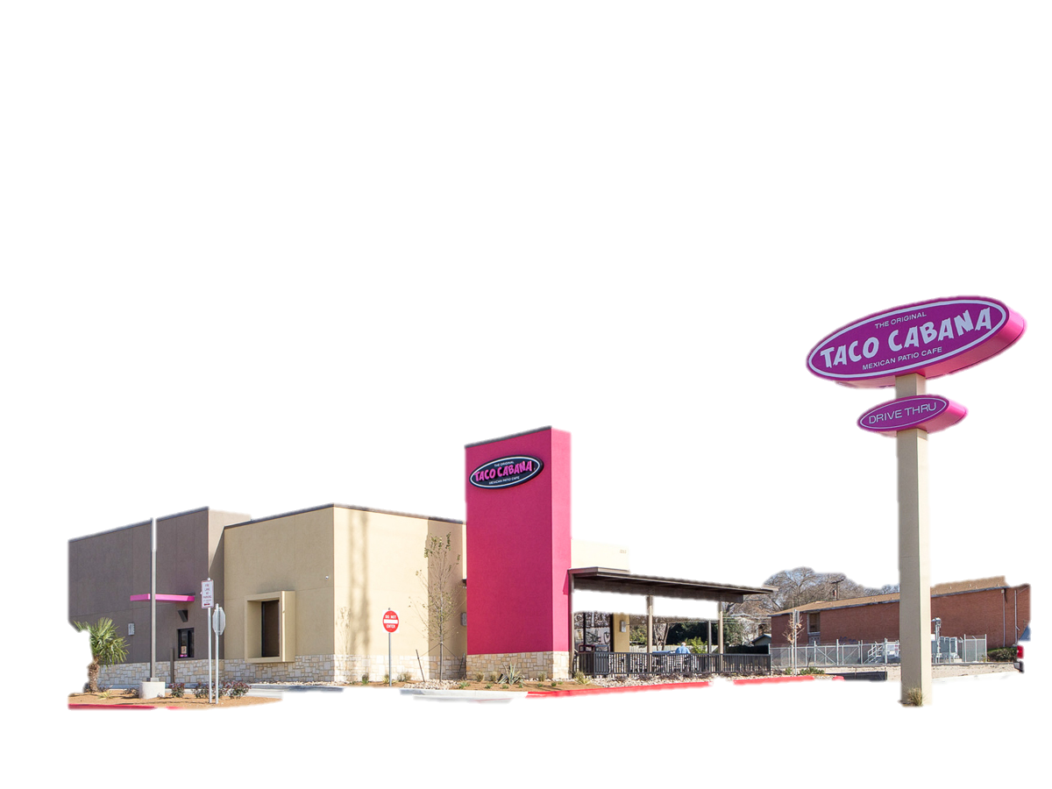
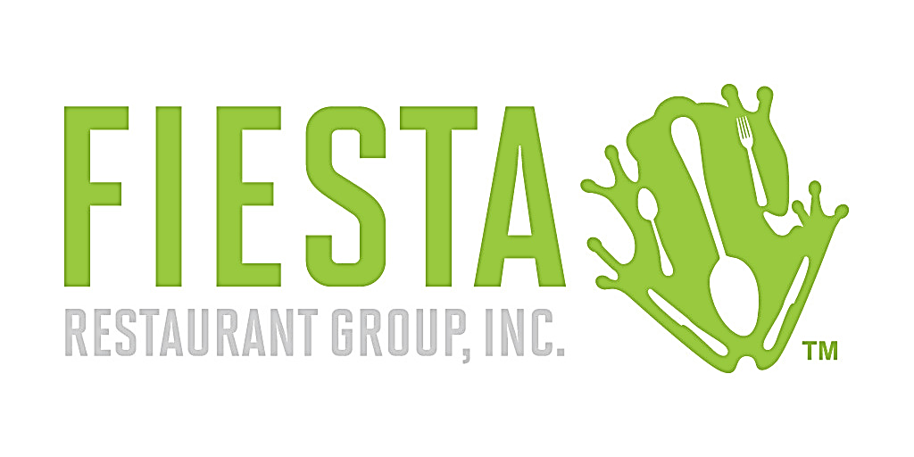

Mystery Consulting
Group Members:
Abbas Hassoun
Hussam Hammad
Majd Boukli Hasan
Matthew Paulsen
BUSI4609 – C
Strategic Management
Instructor: Cheryl Volesky

Slide 2
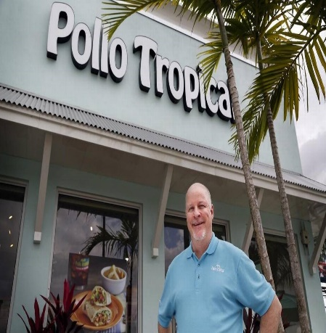
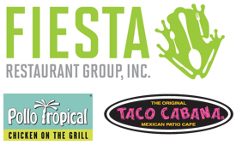
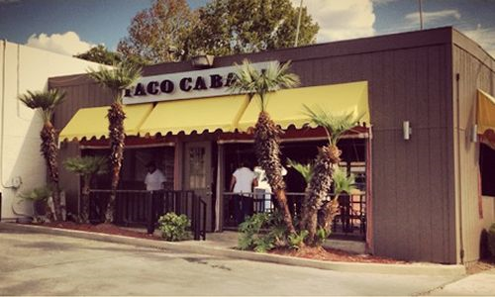

History of Fiesta Restaurant Group Inc.
Fiesta Restaurant Group Bought Taco Cabana & Pollo Tropical
Taco Cabana Founded
1978
2011
1988
2018
Pollo Tropical Founded
Today …

Slide 3
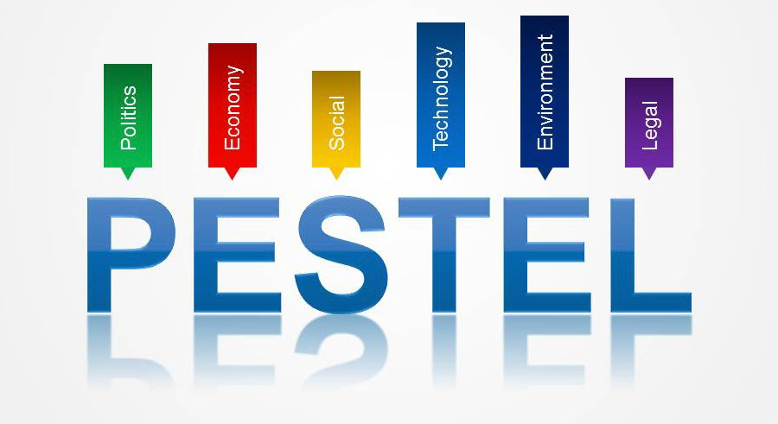
Macro Environment
Technology
Economic
Legal-Political
Demographic

Slide 4
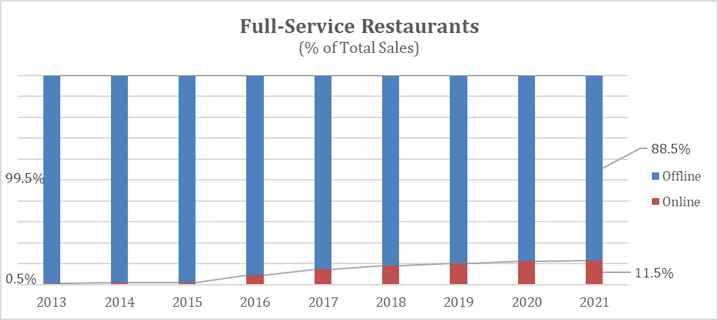
Technological Environment
Mobile Experience and M-Commerce (Threat)
Smart-Speakers (Threat)

Slide 5
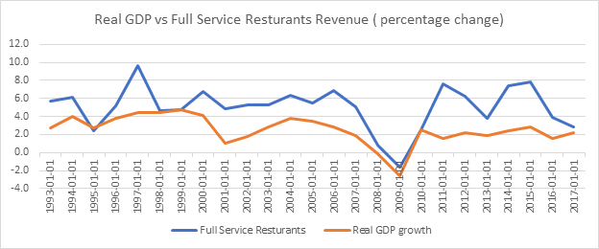
Economic Environment
Real GDP per Capita (Threat)
Expected stagnation after 2017
Real Disposable Income (Opportunity)
Notes:
Disposable income – find beyond 2017
2018 - as per July 2018, rest of the years as the ending value per year (dec 31, YYYY)

Slide 6
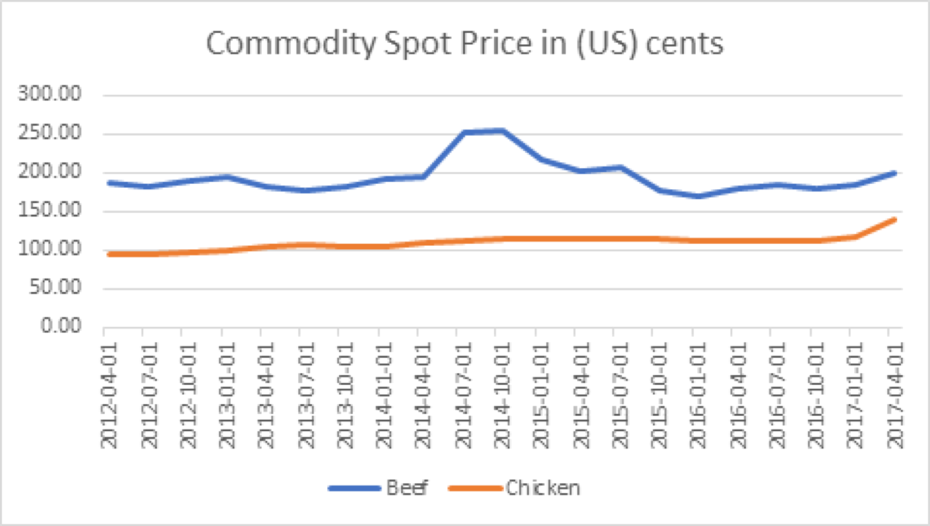
Economic Environment
Price of Beef and Chicken (Opportunity)
Low prices
Notes:
Disposable income – find beyond 2017

Slide 7
Socio-Cultural Environment
Rising Hispanic Population (Opportunity)
The rising Hispanic Population in the U.S. provides firms serving Mexican, Latin and other similar types of foods a larger base to target
Food/Dietary Trends (Threat)
Food/Dietary trends include consumers switching to healthier lifestyles and paying more attention to calorie intake
Consumer Spending (Threat)
Spending at home, etc.
Notes:
Replace graph consumer spending with spending (home vs outside)

Slide 8
Legal/Political Environment
Government Subsidies to Suppliers (Opportunity)
Increased subsidies to farm suppliers by $12B from the Trump administration allows them to charge lower prices to restaurants
Cut in Corporate Tax Rate (Opportunity)
Decrease in corporate tax allows firms to retain more capital to grow businesses
Affordable Health Act – Obamacare (Threat)
Health compensation will be transferred to the employer’s liabilities
Notes:
- Labour – affordable health care
Trump subsidy to farmers
Decrease in corporate tax rate

Slide 9
Industry Analysis

Slide 10
Threat of Entries – (Ranking: 5)
Presence of Well-Established firms
Large number of well-established firms in the industry
Industry switching costs are relatively low
Rivalry – (Ranking: 9)
Highly saturated market
Large number of competitors present
Industry is currently in a mature stage, which typically corresponds with a large number of competitors being present in the industry

Slide 11
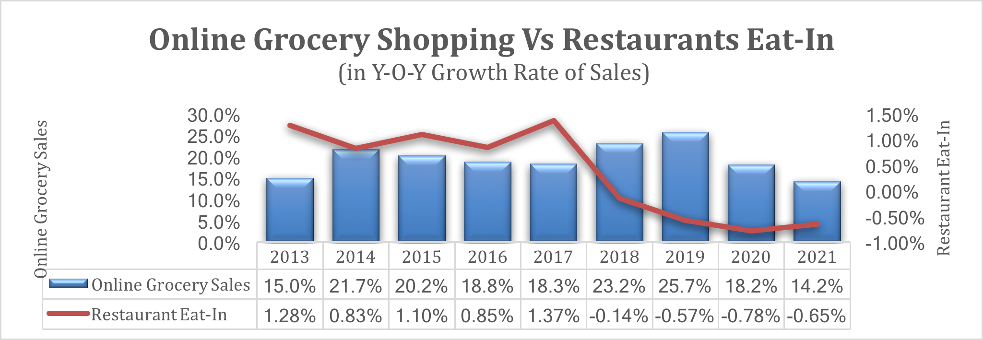
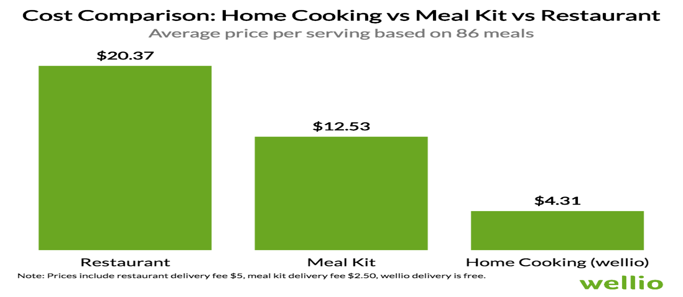
Threat of Substitution – (Ranking: 7)
Online Grocery Shopping – New Alternative
Substitutes now not only include other restaurants, but also online grocery shopping to facilitate eating at home!
Costs of Home Cooking
Low cost of Home Cooking allows customers to incur low switching costs (in fact, they may even save compared to eating at restaurants)

Slide 12
Power of Suppliers – (Ranking: 3)
Moderate Supplier Power
Large Firms – Many Suppliers
Large firms in this industry (i.e. Chipotle, Yum! Brands, etc.) tend to have many suppliers
Power of Buyers – (Ranking: 8)
Zero switching costs – No commitment

Slide 13
Five Forces Summary
1 5 10
Porter’s Forces
Weights
Score
Increasingly Unfavorable
Rivalry
0.3
9
Buyers
0.2
8
Substitution
0.3
7
Entries
0.1
5
Suppliers
0.1
3
Weighted Average
7.2
Notes:
Conclusion: mildly unattractive due to significant substitution, rivalry and buyer power

Slide 14
Driving Forces
Problem
Mobile Integration
Consumer preference toward smartphones
Consumer behaviour
Social Media
Notes:
Consumer demographics: Consumer spending habits / behaviour
Technological advances: Mobile integration

Slide 15
Strategic Map

Slide 16
Strategic Map
Notes:
Change the y-axis to more common index

Slide 17
Firm Environment

Slide 18
Primary Value Chain

Slide 19
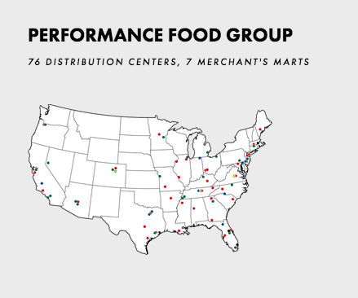
Distribution
Distribution Logistics (Strength)
The firm’s main supplier operates a large number of distribution centers in Florida and Texas – its 2 main states of operations
Supplier Relation (Weakness)
With Fiesta consolidating its supplier to Performance Food Group, the firm has increased its dependence on one supplier

Slide 20
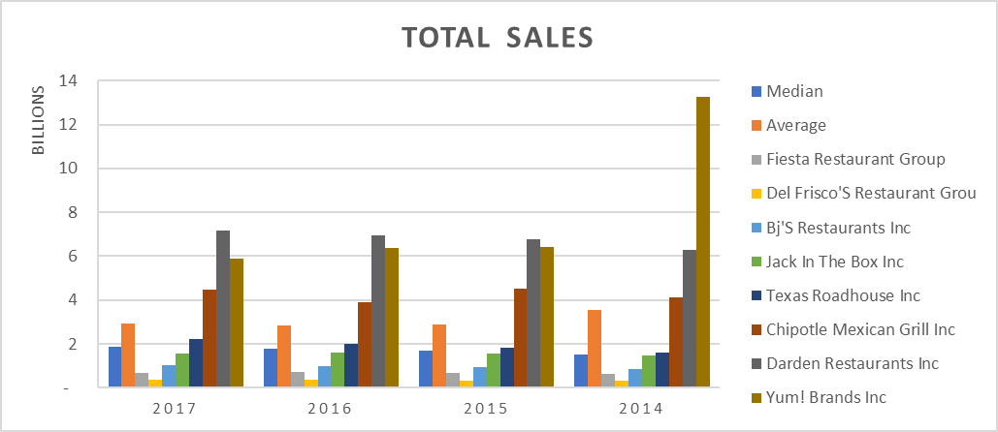
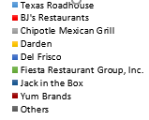
Marketing and Sales
Sales (Strength)
Firms significant strength in revenues showcased by growth – despite lack of marketing
Drop in 2017 attributed to significant store closures from Hurricanes Irma and Harvey
Market Share (Weakness)
Firm currently has a low market share, which is as a result of the firm not operating in a significant number of states compared to some multinational competitors
94.2%
94.0%
94.0%
Notes:
Fix the market share graph to be more clearer

Slide 21
Marketing and Sales
Social Media (Weakness)
Firm lacks a significant social media presence, especially with the leading network (Instagram)
Search Trends and Exposure (Weakness)
Firm does not have significant search traffic for its two brands, which indicates reduced recognition

Slide 22
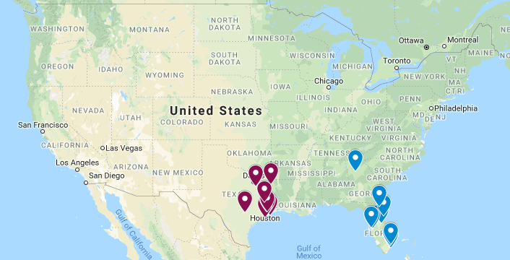
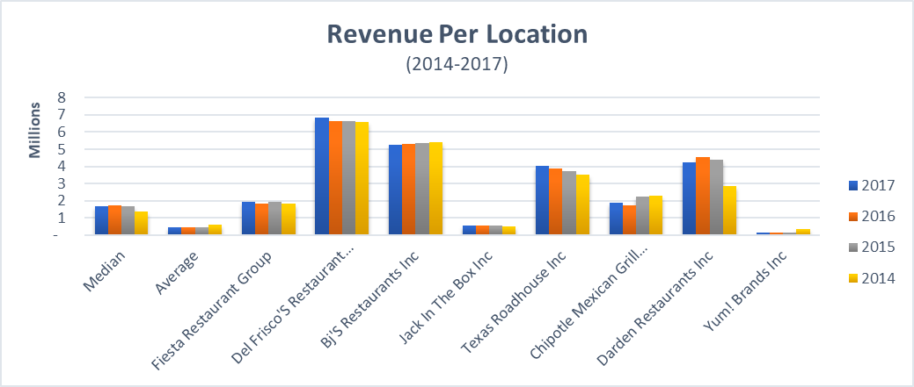
Operations
Restaurant Locations (Weakness)
Firm operates mostly in Texas (Red for Taco Cabana) and Florida (Blue for Pollo Tropical)
Profitability (Weakness)
Firm value still fluctuating at a similar amount from prior years which is well below some significant competitors

Slide 23
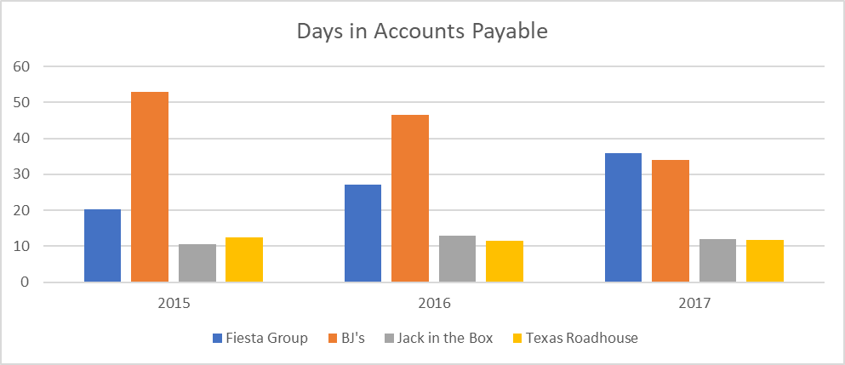
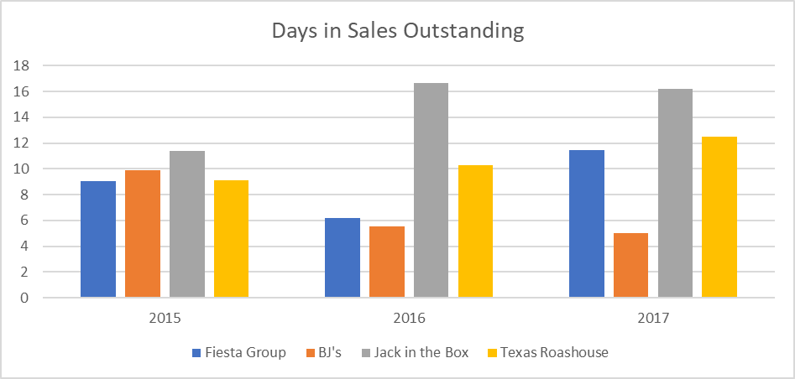
Supply Chain Management
Days in Accounts Payable (Weakness)
Significant number of days indicates liquidity issues as well as potential damage to firm’s credit rating
Days in Sales Outstanding (Strength)
Firm has an efficient collection ability, with the days sales outstanding being significantly low

Slide 24
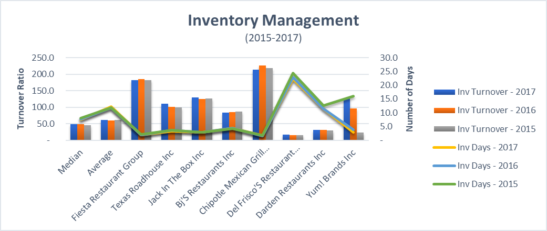
Supply Chain Management
Inventory Management (Strength)
Fiesta has showcased operational improvements in converting inventory to sales, as evidenced by the graphs
Notes:
Add one more metric

Slide 25
Customer Service
Community Outreach (Strength)
Fiesta contributed significant assistance by contributing hot meals to those responding to Hurricane Harvey and Irma disasters
Fiesta also offered meals to first responders to the Parkland shooting
These significant activities showcase Fiesta’s willingness to contribute to the community
Rewards & Loyalty Programs (Weakness)
Despite significant community involvement, the Firm does not have a loyalty program currently set up
This makes customer retention more difficult as well as essentially making switching costs next to nil

Slide 26
Secondary Value Chain

Slide 27
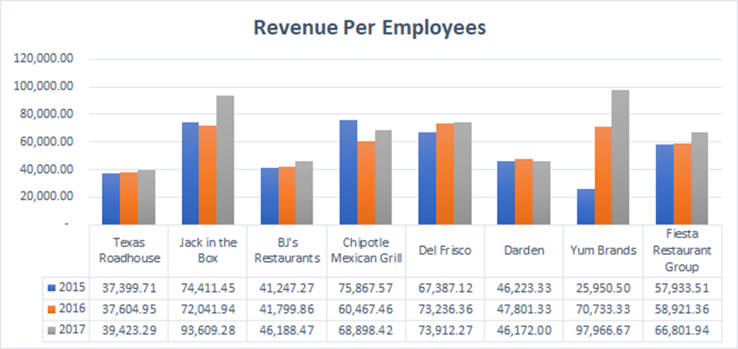
Human Resources Management
Number of Employees Declining (Weakness)
Number of employees in industry has been declining altogether
Revenues per Employee (Strength)
The firm operates with stable revenues and with the decline of employees, the firm experienced a sharp increase in 2017

Slide 28
Research and Development
R&D spending (Weakness)
Fiesta has no research and development expenses in the last 3 years
The lack of R&D is not only with Fiesta however, but almost all other firms outside of Darden and Yum! Brands
However, Fiesta’s “Plan” moving forward includes data analytics to collect data for operational improvement, which could help improve R&D

Slide 29

Corporate Leadership
CEO and President of Fiesta: Richard Stockinger
Stockinger has significant experience bringing struggling restaurants back to profitability

Slide 30
Market Capitalization & Other Metrics

Slide 31
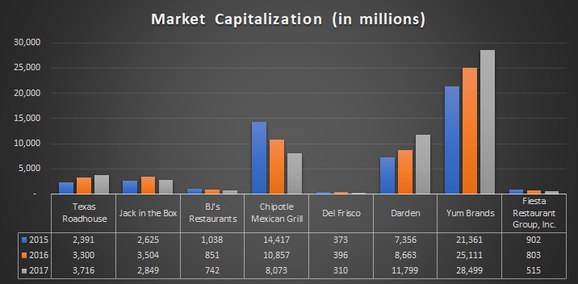
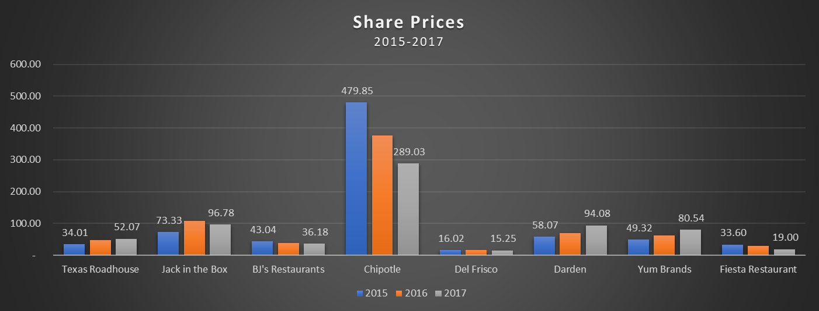
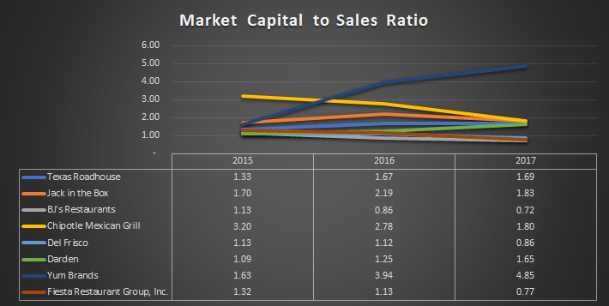
Corporate Metrics
Relative to others, Fiesta falls below the market average in its industry
Declining Market Capitalization over the past three years by 43%.
Fiesta’s share price has declined in 2017 to $19/share from $29.85/share in 2016. This marks a decline of 36% in share price
Moderate level of Market Cap-to-Sales ratio; With 0.77 in 2017, Fiesta deemed to be highly attractive using this metric.

Slide 32
Corporate Metrics
This negative EPS is a major problem for Fiesta as from an investors perspective, Fiesta would appear to not have enough funds to pay any dividends or further invest in assets to facilitate growth.
the EPS for Fiesta has declined significantly due to the losses sustained in the 2017 fiscal year (down to -$1.35 and a percentage decline of 317.7%).
EBITDA for Fiesta has declined in 2017 to $67.4 million from $92.8 million in 2016. Around 27.3% loss in operating income.
Fiesta’s operational performance has been declining for the past two years, especially in 2017 where the EBITDA declined by almost a third.

Slide 33
Factor Evaluation Matrix
IFE
Strong
Average
Weak
External Factor Evaluation (EFE) : 2.5
Internal Factor Evaluation (IFE) : 1.98
High
The firm has an average response to external opportunities and threats relative to its competitors
The firm has a weak internal structure which impacts its operation strategy
EFE
Medium
Low
EFE
IFE

Slide 34
Corporate Strategy

Slide 35
Vertical Integration
Fiesta is engaged in downstream vertical
integration in the value chain system
As of January 2018, Fiesta has taken measures to engage in backward vertical integration by controlling the feed and breed of all chicken purchased for Pollo Tropical’s operations

Slide 36
Horizontal Integration
Fiesta operates under the following NAICS classification
For its two brands the firm has the following NAICS code: 722511, which is the code for full-service restaurants
Weak Financials
Weak Operations
Lack of Horizontal Integration
Given Fiesta’s current corporate strategy, there is no activity towards acquisition of businesses
Furthermore, Fiesta’s loan obligations under its current senior crediting facility has implemented negative covenants that would make it impossible for Fiesta to acquire any businesses

Slide 37
Geographic Integration
Similar to Pollo Tropical, Taco Cabana has a weak national and global presence
These franchise agreements in Guyana and Panama are insignificantly monitored by Fiesta – franchise agreements in place

Slide 38
Problems with Current Corporate Strategy
Vertical
Horizontal
Geographic
Fiesta is using unnecessary resources by engaging in mid-stream value chain activities.
Fiesta’s core business is concentrated within the full-service restaurants
Due to negative covenants the firm can’t make any capital structure modifications
83% of all Pollo Tropical restaurant locations are in Florida and 99% of all Taco Cabana locations are in Texas
Weakness
Strength

Slide 39
Business-Functional Strategies

Slide 40
Current Business Strategy
Restaurant Service Breadth:
The firm manages to offer affordable and cost-incentive generic products to bring in more customers every day without specifications as to who the firm is targeting
Many competitors within the full-service restaurant industry are also using the cost leadership strategy due to the generic product offerings and minimal differentiation that limits the ability to choose between the other strategies
Therefore, it difficult to maintain a competitive edge with such strategy
Competitive Advantage
Lower Cost
Differentiation
Broad
Cost Leadership
Differentiation
Competitive Scope
Cost Focus
Focused Differentiation
Narrow
Prices
Average Unit Cost
Notes:
Mention only serve mexican and Caribbean in 2 states

Slide 41
Problems with Current Business Strategy
Current problems with the strategy relate to the following value chain activities:
Inadequate Operations & Corporate Leadership
Supply Chain Issues
Marketing, R&D and Customer Service
Human Resources

Slide 42
Recommendations

Slide 43
Corporate Recommendation
National Expansion Strategy:
New Mexico (Taco Cabana):
Large number of searches for Taco Cabana in New Mexico
New Mexico’s racial demographic offer an advantage:
New Mexico has the largest proportion of Latin-Americans relative to any other state in the country

Slide 44
Corporate Recommendation
National Expansion Strategy:
Georgia (Pollo Tropical):
Georgia has the lowest frequency of natural disasters relative to any other southern state
Georgia has a significant population of 10.4 Million inhabitants growing at 1.1% annually
Growth in Georgia provides the industry a larges market

Slide 45
Corporate Recommendation – Action Plan
Liquidation & Relocation
Lease Contracts and Renovations
Suppliers Contracts
Hiring and Training
Finalization
Liquidation & Relocation (8 – 10 Weeks)
Liquidating seven stores in total
To Georgia and New Mexico
Lease Contracts & Renovations (5 – 6 Weeks)
Signing new leases
Internal design and decorations
Suppliers Contracts (1 – 2 Weeks)
Signing contracts with local suppliers
Hiring & Training (5 – 6 Weeks)
Begin searching for local talents
Training the new hires
Finalizing (2 – 4 Weeks)
Insuring the process is back to normal

Slide 46
Corporate Recommendation – Cost Analysis
Pollo Tropical – Expected Scenario
Initial Investment: $ -7.2 M
Total Return: $ 17.6 M
Net Present Value: $ 10.4 M
Current Revenue Generated by one store: $ 2.3 M
Upturn of this investment: $ 1.2 M annually

Slide 47
Corporate Recommendation – Cost Analysis
Taco Cabana – Expected Scenario
Initial Investment: $ -4.5 M
Total Return: $ 5.9 M
Net Present Value: $ 1.4 M
Current Revenue Generated by one store: $ 1.8 M
Downturn of this investment: $ 0.62 M annually

Slide 48
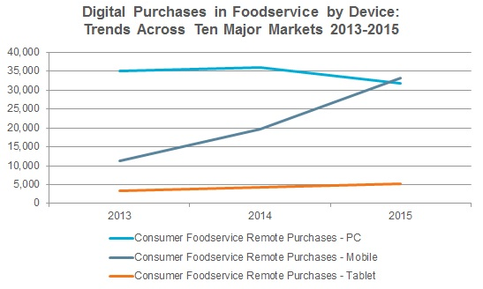
Business-Functional Recommendation
Primary Recommendation: Fiesta Mobile App
As indicated in the figure to the right, usage of mobile phone applications and digital purchases are rising
Application features includes:
Mobile Proximity
Personalization through collected data
Allows for in-App advertisements
Allows for voice-over orders
In App customer IT support
Loyalty programs
Link to third-party App deliveries
Notes:
How will this help?
Increased consumer engagement due to larger consumer application usage
Data collection for R&D purposes
Inventory tracking
Advertising savings due to increased application usage
Rewards programs to increase retention and loyalty
Increased revenue due to application will help ROIC and other metrics
Significant improvements operationally to increase profits and thereby improve market cap, share price and EPS

Slide 49
Primary Recommendation – Action Plan
Pre-development (3 – 4 Weeks)
Research
Business Requirements
Budgeting And Fund Raise
Development (14 – 16 Weeks)
Back-end Development
Cloud
App Design
Internal Testing
Implementation (9 – 10 Weeks)
Sample Market Testing
National Wide Implementation
App Announcement (Social Media)
On-going Support
On-call Support Staff

Slide 50
Primary Recommendation – Cost Analysis
Cost Analysis:
Initial Investment: $ -277 K
Net Present Value: $ 78.6 M

Slide 51
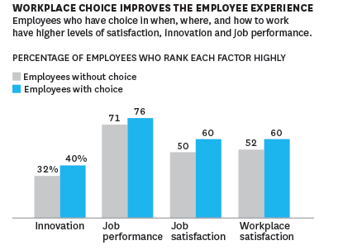
Business-Functional Recommendation
Secondary Recommendation: HR Plan
Fiesta also has a significant employee turnover issue, which is also an industry wide problem
Introduction of this plan would result in more employee loyalty, more effort during work and a reduced overall turnover
Fiesta’s programs to implement includes two components:
Improved hiring/selection process, increased employee autonomy and conducting exit interviews
Employee recognition via employee of the month publications and other formal announcements

Slide 52
Secondary Recommendation – Analysis
Action Plan:
Strategy Start (3 – 4 Weeks)
Conduct research and surveys
Design New hiring process
Implementation (24 – 28 Weeks)
Market Testing – Sample Analysis
Nation Wide Implementation
Reshaping The Employees Valuation Metrics
Employee Satisfaction Surveys (Milestone)
On-Going Operations
Continuous Strategy Support
Cost Analysis:
Initial Investment: $ -1.01 M
Total Return: $ 5.0 M
Net Present Value: $ 3.9 M

Slide 53
Financing the Recommendations – Business Strategy
Restaurant Liquidation (Corporate Strategy)
Fiesta’s negative covenants make issuing new shares or entering new debt agreements impossible. Therefore to finance the corporate recommendation, Fiesta will liquidate locations.
To finance the business recommendations, Fiesta will reduce other advertising expenses and allocate costs towards the recommendations.
Debt Restriction – Negative Covenants
Through Cost Savings (Business Strategy)

Slide 54
Conclusion

Slide 55
Expected Results
The expected results include improved profitability, lower costs, more customer awareness and more efficient operations

Slide 56
Thank You!
Questions?

Slide 57
Appendix

Slide 58
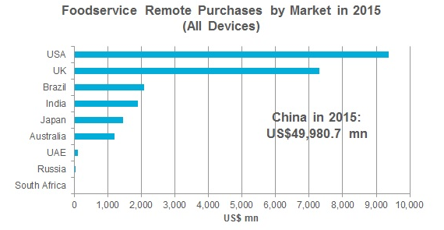
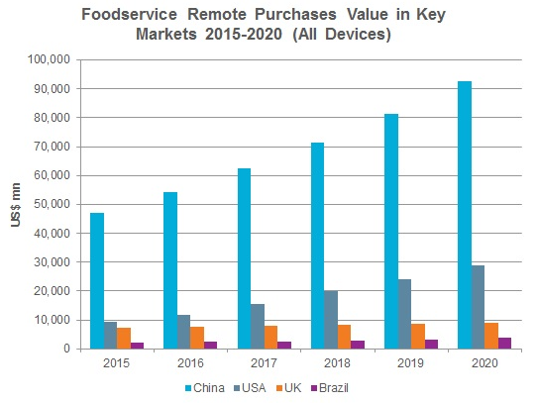
Mobile Proximity

Slide 59
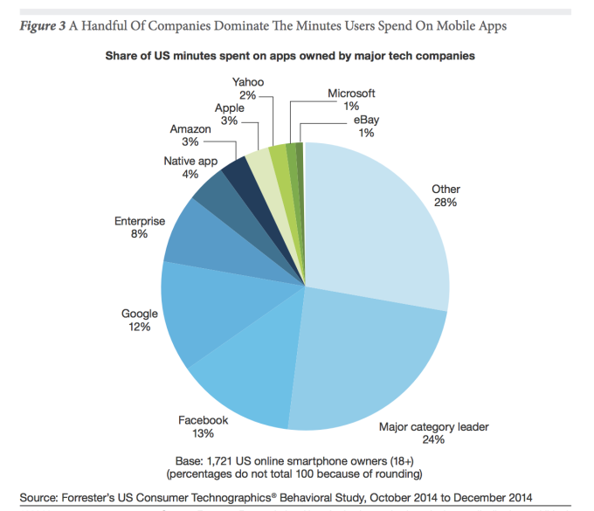
Mobile App Usage

Slide 60
Data Collection

Slide 61
Cost of Capital

Slide 62
Locations
App on Revenue
Benefits: | Expected Benefits (Increase in Revenue) :
M-Restaurant Environment | 30.00%
Personalized Deals | 20.00%
In-App advertisements | Savings in Ads Exp.
Loyalty programs (+5% retention) | 25.00%
Average Growth | 25.00%
Brand | Owned | Franchise | Total
Pollo Tropical | 146 | 25 | 171
Taco Cabana | 166 | 37 | 203
Total | 312 | 62 | 374

Slide 63
Multi-Criteria Analysis
Cost
Control
Capable
1 2 3
Increasingly Favourable
Geographic Expansion
2
3
2
12
3
2.5
1
7.5
Mobile App
1
1
1
1
HR Plan
1
3
3
9
Doing Nothing

Slide 64
HR Plan
Note 1:
The average cost of developing a new and comprehensive training program is up to $12,250.56 This includes costs associated with planning, testing and evaluating to ensure effectiveness.
Note 2:
The expected cost associated with training the current employees is calculated as follows:
- As per a study conducted by Cornell University, the average cost for employee retraining and orientation is 14% of the original cost.57 In this case, the average cost per training originally was $824, so a 14% calculation would then be $115/employee. With the firm employing 10,090 front-line employees, the total cost would then be approximately $1 million.
Note 3:
The average cost of employee turnover per full-service restaurant in the United States is $146,600.58 With an expected reduction of 10% in employee turnover, then the expected cost recovery per restaurant for Fiesta would be $14,660. With the firm having 171 Pollo Tropical locations and 171 Taco Cabana locations, the firm would realize an expected saving of approximately $5 Million (342 locations * $14,660).
It is important to note that while the costs associated with the retraining have been monetized above, there are still significant costs that cannot be monetized. This includes time spent by corporate staff and management. Furthermore, for the implementation, it is important that all restaurant-level staff participate in the training.

Slide 65
Primary Value Chain VRIO
Distribution
Marketing and Sales
Operations
Supply Chain Management
Customer Service
Value
No
No
No
No
No
Rare
No
No
No
No
Yes
Costly To Imitate
No
No
No
No
No
Organized to Be Exploited
No
No
No
No
No

Slide 66
Secondary Value Chain VRIO
Human Resources Management
Research and Development
Corporate Leadership
Value
No
Yes
Yes
Rare
No
No
No
Costly To Imitate
No
No
No
Organized to Be Exploited
Yes
No
No

Slide 67
MOST Analysis
MOST Analysis | Overall | Score
Definition | The firm needs to define MOST more and update it regularly. It is somewhat challenging to extract all the elements. Most of the elements are aligned with each other but, for tactics, having a focus on efficiency and creativity is a killer to most companies. Also, these elements lack the sense of priority and time orientation. | Weakness
Clarity | The firm does not have a clear MOST direction and plan to achieve its goals. | Weakness
Communication | MOST elements are not communicated clearly, so the viewer needs to decipher the given data in order to understand the firm’s activities. | Weakness
Organizational Commitment | The firm indicates that it has a strong brand recognition, yet it plans to reposition the brands. So, MOST is inconsistent among the organization departments. | Weakness
Summary | MOST allows the stakeholders to understand the purpose of this firm, however, the information provided is inconsistent and unclear to the reader. So, updating MOST frequently and communicating with the stakeholders more openly is going to strengthen the organization’s position. Therefore, The lack of proper mission and vision statement represents a weakness to the firm.

